Slide 1
Detection Limits for Spectrophotometer Lab
By Honors Students

Slide 2
Detection Limits
A detection limit is the unique lowest possible amount of an element that can be detected by a spectrophotometer.
If a certain element is not detected by the spectrophotometer, the element may still be present, but in an amount lower than its specific detection limit.
Detection limits are generally defined by upper and lower bounds. The upper bound is the lowest quantity of the sample that was still detected by the spectrophotometer. The lower bound is the highest quantity of the sample that could not be detected. The exact detection limit of the element will be between these two bounds.

Slide 3
How to Find Detection Limits
In order to find our detection limits we started with a 0.5 molar solution that we knew could be detected by the spectrophotometer.
In order to make a 0.5 molar solution we took a certain amount of our solute, a different amount for each element.
For example, for sodium, we put 0.22 grams of NaCl in 100 ml of distilled water, and this made a 0.5 molar solution.

Slide 4
Relevance
Knowing the methodology detection limit is important, because it provides an explanation for why an element cannot be detected.
That element would either not be present or be present in amounts lower than its detection limit.

Slide 5
Results
Then we decreased the moles of the solute in our solution by ⅕ so the next solution was a 0.1 molar solution. This solution would be far more diluted, making it more difficult to detect the solute.
For sodium, we found that the detection limit lower bound was 0.00016 which translates to 3,680 parts per billion.
The upper bound of our detection limit was 0.0008 which translates to 18,400 parts per billion

Slide 6
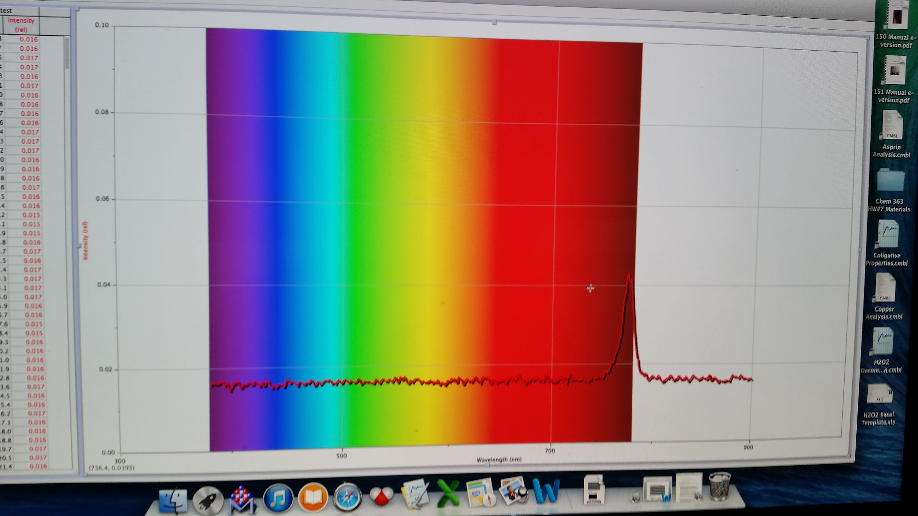
Positive results are seen on the spectrophotometer as

Slide 7
Upper and Lower Bounds of all Metals Detected

